Slide 1
Java Script
Module 2

Slide 2
Content
JavaScript Errors
JavaScript Exception Handling
Document Object Model

Slide 3
JavaScript Errors
The try statement lets you test a block of code for errors.
The catch statement lets you handle the error.
The throw statement lets you create custom errors.
The finally statement lets you execute code, after try and catch, regardless of the result.

Slide 4
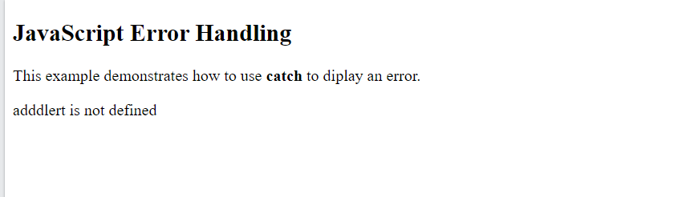
JavaScript Errors
<!DOCTYPE html>
<html>
<body>
<h2>JavaScript Error Handling</h2>
<p>This example demonstrates how to use <b>catch</b> to diplay an error.</p>
<p id="demo"></p>
<script>
try {
adddlert("Welcome guest!");
}
catch(err) {
document.getElementById("demo").innerHTML = err.message;
}
</script>
</body>
</html>
When executing JavaScript code, different errors can occur.
Errors can be coding errors made by the programmer, errors due to wrong input, and other unforeseeable things.
Example
In this example we misspelled "alert" as "adddlert" to deliberately produce an error
JavaScript catches adddlert as an error, and executes the catch code to handle it.

Slide 5
JavaScript try and catch
<!DOCTYPE html>
<html>
<body>
<h2>JavaScript Error Handling</h2>
<p>This example demonstrates how to use <b>catch</b> to diplay an error.</p>
<p id="demo"></p>
<script>
try {
adddlert("Welcome guest!");
}
catch(err) {
document.getElementById("demo").innerHTML = err.message;
}
</script>
</body>
</html>
The try statement allows you to define a block of code to be tested for errors while it is being executed.
The catch statement allows you to define a block of code to be executed, if an error occurs in the try block.
The JavaScript statements try and catch come in pairs
try {
Block of code to try
}
catch(err) {
Block of code to handle errors
}

Slide 6
JavaScript Throws Errors
When an error occurs, JavaScript will normally stop and generate an error message.
The technical term for this is: JavaScript will throw an exception (throw an error).
JavaScript will actually create an Error object with two properties:
name
message.
The throw Statement
The throw statement allows you to create a custom error.
Technically you can throw an exception (throw an error).
The exception can be a JavaScript String, a Number, a Boolean or an Object:
throw "Too big"; // throw a text
throw 500; // throw a number
If you use throw together with try and catch, you can control program flow and generate custom error messages.

Slide 7
The throw Statement
The throw statement allows you to create a custom error.
Technically you can throw an exception (throw an error).
The exception can be a JavaScript String, a Number, a Boolean or an Object:
throw "Too big"; // throw a text
throw 500; // throw a number
If you use throw together with try and catch, you can control program flow and generate custom error messages.

Slide 8
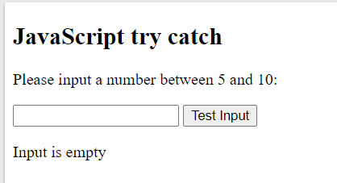
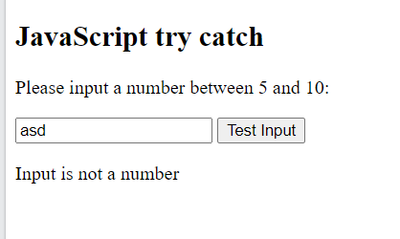
Input Validation
This example examines input. If the value is wrong, an exception (err) is thrown.
The exception (err) is caught by the catch statement and a custom error message is displayed:
<!DOCTYPE html>
<html>
<body>
<h2>JavaScript try catch</h2>
<p>Please input a number between 5 and 10:</p>
<input id="demo" type="text">
<button type="button" onclick="myFunction()">Test Input</button>
<p id="p01"></p>
<script>
function myFunction() {
const message = document.getElementById("p01");
message.innerHTML = "";
let x = document.getElementById("demo").value;
try {
if(x == "") throw "empty";
if(isNaN(x)) throw "not a number";
x = Number(x);
if(x < 5) throw "too low";
if(x > 10) throw "too high";
}
catch(err) {
message.innerHTML = "Input is " + err;
}
}
</script>
</body>
</html>

Slide 9
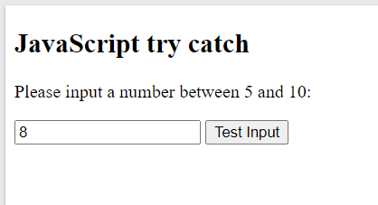


Input Validation
This example examines input. If the value is wrong, an exception (err) is thrown.
The exception (err) is caught by the catch statement and a custom error message is displayed:
<!DOCTYPE html>
<html>
<body>
<h2>JavaScript try catch</h2>
<p>Please input a number between 5 and 10:</p>
<input id="demo" type="text">
<button type="button" onclick="myFunction()">Test Input</button>
<p id="p01"></p>
<script>
function myFunction() {
const message = document.getElementById("p01");
message.innerHTML = "";
let x = document.getElementById("demo").value;
try {
if(x == "") throw "empty";
if(isNaN(x)) throw "not a number";
x = Number(x);
if(x < 5) throw "too low";
if(x > 10) throw "too high";
}
catch(err) {
message.innerHTML = "Input is " + err;
}
}
</script>
</body>
</html>

Slide 10
finally statement
<!DOCTYPE html>
<html>
<body>
<h2>JavaScript try catch</h2>
<p>Please input a number between 5 and 10:</p>
<input id="demo" type="text">
<button type="button" onclick="myFunction()">Test Input</button>
<p id="p01"></p>
<script>
function myFunction() {
const message = document.getElementById("p01");
message.innerHTML = "";
let x = document.getElementById("demo").value;
try {
if(x == "") throw "is empty";
if(isNaN(x)) throw "is not a number";
x = Number(x);
if(x > 10) throw "is too high";
if(x < 5) throw "is too low";
}
catch(err) {
message.innerHTML = "Input " + err;
}
finally {
document.getElementById("demo").value = "";
}
}
</script>
</body>
</html>
The finally statement lets you execute code, after try and catch, regardless of the result:
Syntax
try {
Block of code to try
}
catch(err) {
Block of code to handle errors
}
finally {
Block of code to be executed regardless of the try / catch result
}

Slide 11
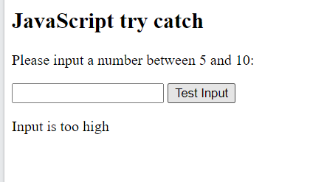
finally statement
<!DOCTYPE html>
<html>
<body>
<h2>JavaScript try catch</h2>
<p>Please input a number between 5 and 10:</p>
<input id="demo" type="text">
<button type="button" onclick="myFunction()">Test Input</button>
<p id="p01"></p>
<script>
function myFunction() {
const message = document.getElementById("p01");
message.innerHTML = "";
let x = document.getElementById("demo").value;
try {
if(x == "") throw "is empty";
if(isNaN(x)) throw "is not a number";
x = Number(x);
if(x > 10) throw "is too high";
if(x < 5) throw "is too low";
}
catch(err) {
message.innerHTML = "Input " + err;
}
finally {
document.getElementById("demo").value = "";
}
}
</script>
</body>
</html>

Slide 12
The Error Object
JavaScript has a built in error object that provides error information when an error occurs.
The error object provides two useful properties: name and message.
Error Object Properties
Property Description
name Sets or returns an error name
message Sets or returns an error message (a string)
Error Name Values

Slide 13
The Error Object
Error Name Values
Six different values can be returned by the error name property:
Error Name Description
EvalError An error has occurred in the eval() function
RangeError A number "out of range" has occurred
ReferenceError An illegal reference has occurred
SyntaxError A syntax error has occurred
TypeError A type error has occurred
URIError An error in encodeURI() has occurred

Slide 14
DOM (Document Object Model)

Slide 15

DOM (Document Object Model)
With the HTML DOM, JavaScript can access and change all the elements of an HTML document.
When a web page is loaded, the browser creates a Document Object Model of the page.
The HTML DOM model is constructed as a tree of Objects:

Slide 16
DOM (Document Object Model)
With the object model, JavaScript gets all the power it needs to create dynamic HTML:
JavaScript can
Change all the HTML elements in the page
Change all the HTML attributes in the page
Change all the CSS styles in the page
Remove existing HTML elements and attributes
Add new HTML elements and attributes
Can react to all existing HTML events in the page
Create new HTML events in the page

Slide 17
What is DOM (Document Object Model)
The DOM is a W3C (World Wide Web Consortium) standard.
The DOM defines a standard for accessing documents:
"The W3C Document Object Model (DOM) is a platform and language-neutral interface that allows programs and scripts to dynamically access and update the content, structure, and style of a document."
The W3C DOM standard is separated into 3 different parts:
Core DOM - standard model for all document types
XML DOM - standard model for XML documents
HTML DOM - standard model for HTML documents

Slide 18
What is HTML DOM?
The HTML DOM is a standard object model and programming interface for HTML.
It defines:
The HTML elements as objects
The properties of all HTML elements
The methods to access all HTML elements
The events for all HTML elements
In other words: The HTML DOM is a standard for how to get, change, add, or delete HTML elements.

Slide 19

DOM Nodes
According to the W3C HTML DOM standard, everything in an HTML document is a node:
The entire document is a document node
Every HTML element is an element node
The text inside HTML elements are text nodes
Every HTML attribute is an attribute node (deprecated)
All comments are comment nodes
With the HTML DOM, all nodes in the node tree can be accessed by JavaScript.
New nodes can be created, and all nodes can be modified or deleted.

Slide 20
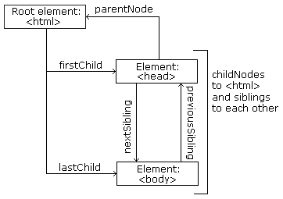
Node Relationships
The nodes in the node tree have a hierarchical relationship to each other.
The terms parent, child, and sibling are used to describe the relationships.
In a node tree, the top node is called the root (or root node)
Every node has exactly one parent, except the root (which has no parent)
A node can have a number of children
Siblings (brothers or sisters) are nodes with the same parent
<html> <head> <title>DOM Tutorial</title> </head> <body> <h1>DOM Lesson one</h1> <p>Hello world!</p> </body> </html>

Slide 21
Node Relationships
From the HTML given we can read
<html> is the root node
<html> has no parents
<html> is the parent of <head> and <body>
<head> is the first child of <html>
<body> is the last child of <html>
<head> has one child: <title>
<title> has one child (a text node): "DOM Tutorial"
<body> has two children: <h1> and <p>
<h1> has one child: "DOM Lesson one"
<p> has one child: "Hello world!"
<h1> and <p> are siblings
<html> <head> <title>DOM Tutorial</title> </head> <body> <h1>DOM Lesson one</h1> <p>Hello world!</p> </body> </html>

Slide 22
Navigation between Nodes
<html> <head> <title>DOM Tutorial</title> </head> <body> <h1>DOM Lesson one</h1> <p>Hello world!</p> </body> </html>
We can use the following node properties to navigate between nodes with JavaScript:
parentNode
childNodes[nodenumber]
firstChild
lastChild
nextSibling
previousSibling

Slide 23
Form Validation

Slide 24
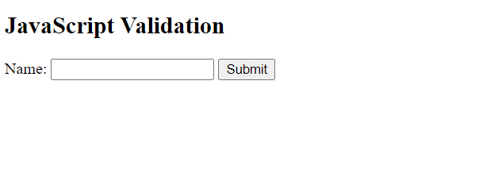
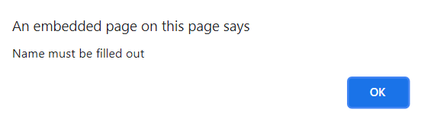
Form Validation
<!DOCTYPE html>
<html>
<head>
<script>
function validateForm() {
let x = document.forms["myForm"]["fname"].value;
if (x == "") {
alert("Name must be filled out");
return false;
}
}
</script>
</head>
<body>
<h2>JavaScript Validation</h2>
<form name="myForm" action="/action_page.php" onsubmit="return validateForm()" method="post">
Name: <input type="text" name="fname">
<input type="submit" value="Submit">
</form>
</body>
</html>
HTML form validation can be done by JavaScript.
If a form field (fname) is empty, this function alerts a message, and returns false, to prevent the form from being submitted
The function can be called when the form is submitted

Slide 25
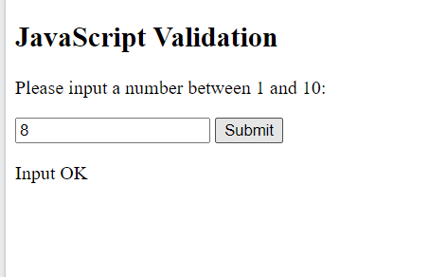

Form Validation
<!DOCTYPE html>
<html>
<body>
<h2>JavaScript Validation</h2>
<p>Please input a number between 1 and 10:</p>
<input id="numb">
<button type="button" onclick="myFunction()">Submit</button>
<p id="demo"></p>
<script>
function myFunction() {
// Get the value of the input field with id="numb"
let x = document.getElementById("numb").value;
// If x is Not a Number or less than one or greater than 10
let text;
if (isNaN(x) || x < 1 || x > 10) {
text = "Input not valid";
} else {
text = "Input OK";
}
document.getElementById("demo").innerHTML = text;
}
</script>
</body>
</html>
Validation of Numeric Inputs

Slide 26
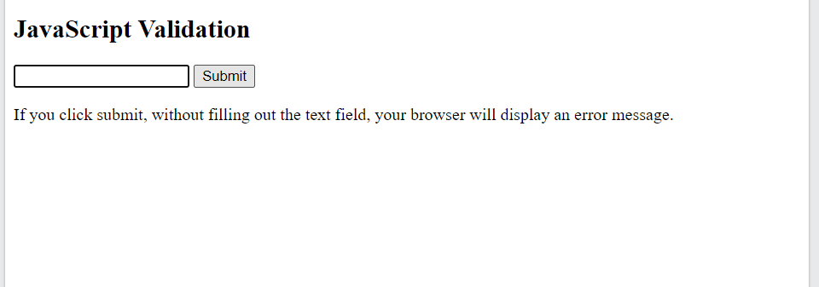

Automatic HTML Form Validation
HTML form validation can be performed automatically by the browser:
If a form field (fname) is empty, the required attribute prevents this form from being submitted
<!DOCTYPE html>
<html>
<body>
<h2>JavaScript Validation</h2>
<form action="/action_page.php" method="post">
<input type="text" name="fname" required>
<input type="submit" value="Submit">
</form>
<p>If you click submit, without filling out the text field,
your browser will display an error message.</p>
</body>
</html>

Slide 27
Data Validation
Data validation is the process of ensuring that user input is clean, correct, and useful.
Typical validation tasks are:
has the user filled in all required fields?
has the user entered a valid date?
has the user entered text in a numeric field?
Most often, the purpose of data validation is to ensure correct user input.
Validation can be defined by many different methods, and deployed in many different ways.
Server side validation: is performed by a web server, after input has been sent to the server.
Client side validation: is performed by a web browser, before input is sent to a web server.

Slide 28
Constraint Validation
HTML5 introduced a new HTML validation concept called constraint validation.
HTML constraint validation is based on:
Constraint validation HTML Input Attributes
Constraint validation CSS Pseudo Selectors
Constraint validation DOM Properties and Methods

Slide 29
Constraint Validation HTML Input Attributes
Attribute Description
disabled Specifies that the input element should be disabled
max Specifies the maximum value of an input element
min Specifies the minimum value of an input element
pattern Specifies the value pattern of an input element
required Specifies that the input field requires an element
type Specifies the type of an input element

Slide 30
Constraint Validation CSS Pseudo Selectors
Selector Description
:disabled Selects input elements with the "disabled" attribute specified
:invalid Selects input elements with invalid values
:optional Selects input elements with no "required" attribute specified
:required Selects input elements with the "required" attribute specified
:valid Selects input elements with valid values

Slide 31
DOM Events

Slide 32
JavaScript HTML DOM Events
HTML DOM allows JavaScript to react to HTML events
A JavaScript can be executed when an event occurs, like when a user clicks on an HTML element.
To execute code when a user clicks on an element, add JavaScript code to an HTML event attribute:
onclick=JavaScript
Examples of HTML events:
When a user clicks the mouse
When a web page has loaded
When an image has been loaded
When the mouse moves over an element
When an input field is changed
When an HTML form is submitted
When a user strokes a key

Slide 33
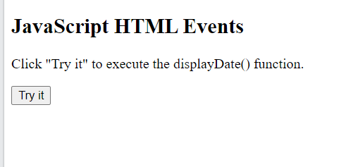
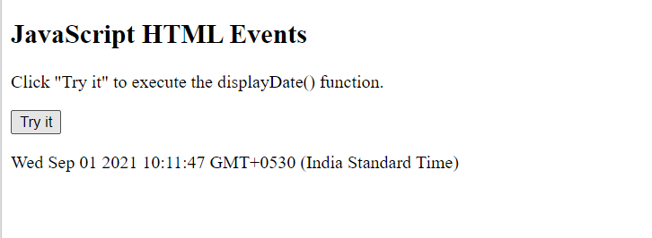
Assign events using HTML DOM
<!DOCTYPE html>
<html>
<body>
<h2>JavaScript HTML Events</h2>
<p>Click "Try it" to execute the displayDate() function.</p>
<button id="myBtn">Try it</button>
<p id="demo"></p>
<script>
document.getElementById("myBtn").onclick = displayDate;
function displayDate() {
document.getElementById("demo").innerHTML = Date();
}
</script>
</body>
</html>

